Slide 1
Enterprise Issue Resolution: Remedy for End Users
Nov 2018

Slide 2
Application Preferences
Benefits of setting up the Application Preferences:
Determines default settings/views
Determines the actions when saving incidents
Note: If you do not configure these actions, your incident will disappear when saving.

Slide 3
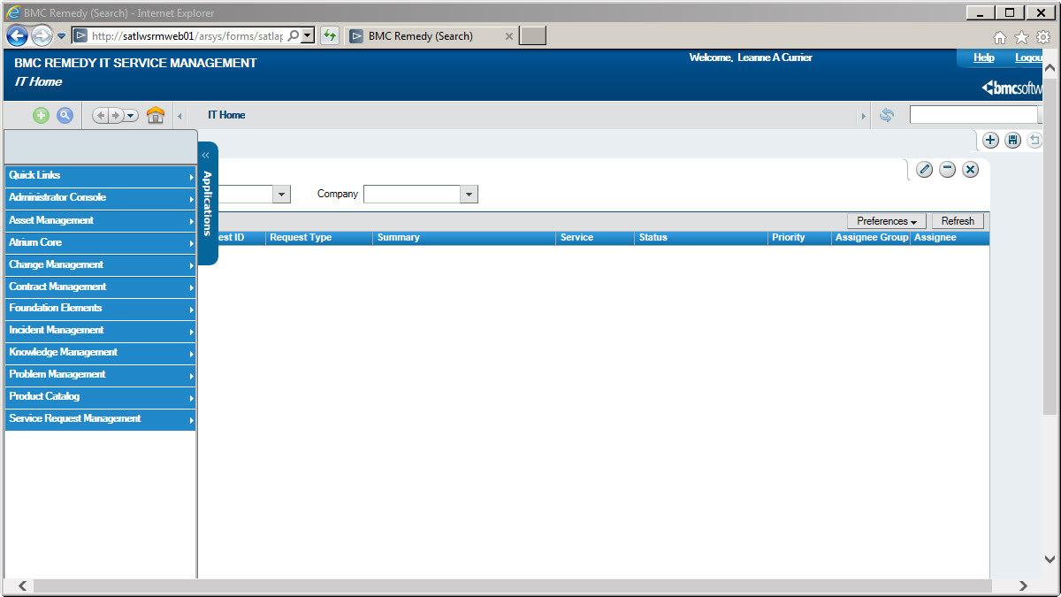
Accessing Application Preferences
Click Applications Tab, then Incident Management, then Incident Management Console
Under Functions, click Application Preferences.

Slide 4
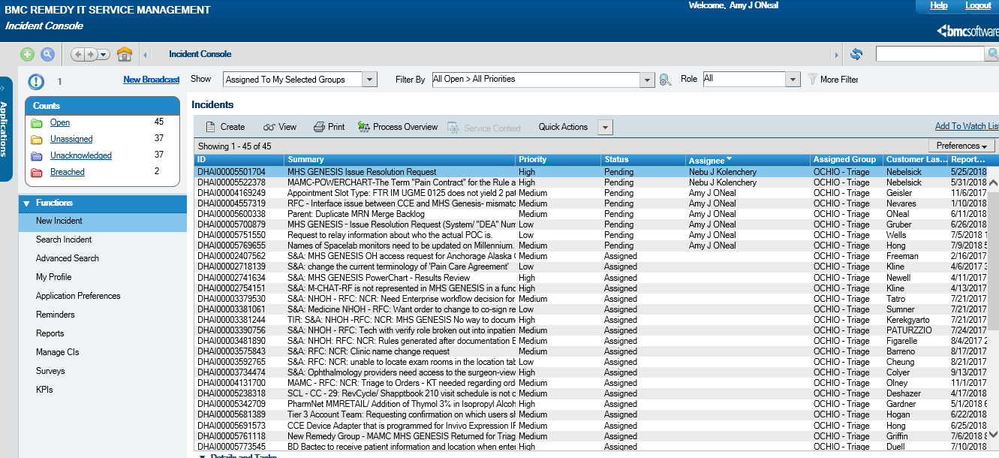
Accessing Application Preferences
Under Functions, click Application Preferences.

Slide 5
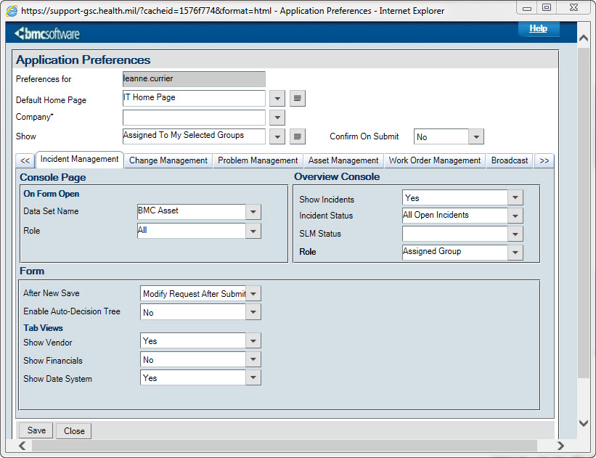
Application Preferences
From the Default Home Page drop down menu, click Incident Management Console.
4. Click Save and Close.

Slide 6
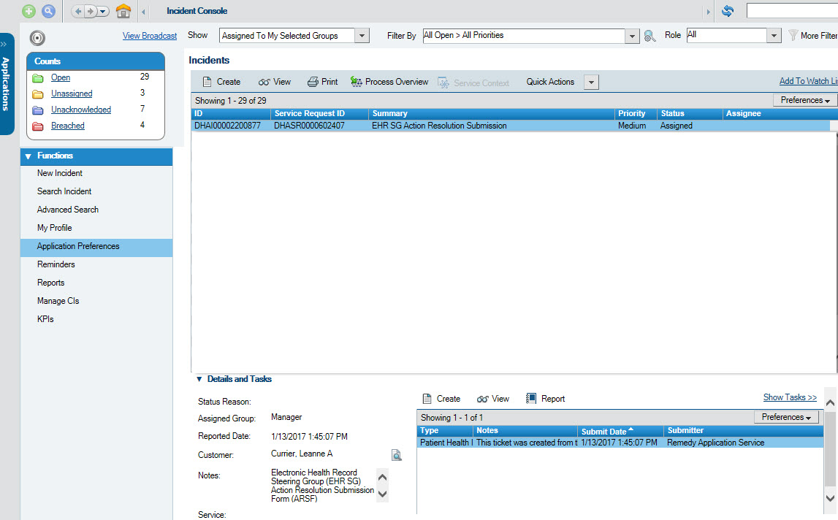
Accessing the Search Incident Window
To navigate to the Search Incident window, click Search Incident under the Functions menu

Slide 7
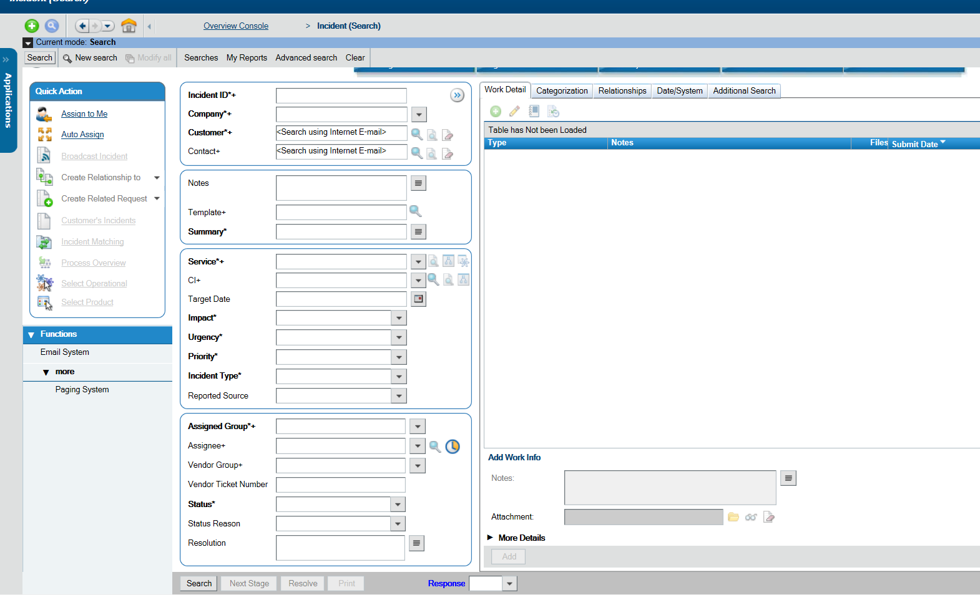
Searching for an Incident (2 of 4)
1
1b
It is fastest and easiest to search by Incident ID you have it.
1b. If not, you can put keywords into the “Notes” field. Be sure to populate any other known fields to make the search faster (See next slide to limit to only MHS GENESIS incidents).
2. When done, click “Save”
2
Notes:
It is fastest and easiest to search by Incident ID you have it.
1b. If not, you can put keywords into the “Notes” field. Be sure to populate any other known fields to make the search faster.
2. When done, click “Search”

Slide 8
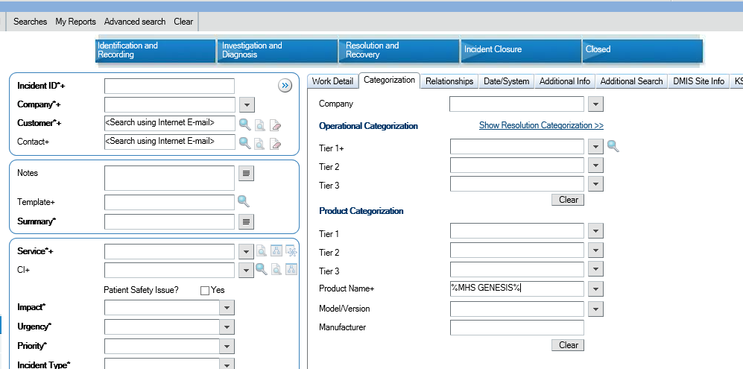
Searching for an Incident (3 of 4)
3. To further limit your search to only MHS GENESIS incidents, click “Categorization”.
4. In “Product Name”, type %MHS GENESIS%

Slide 9
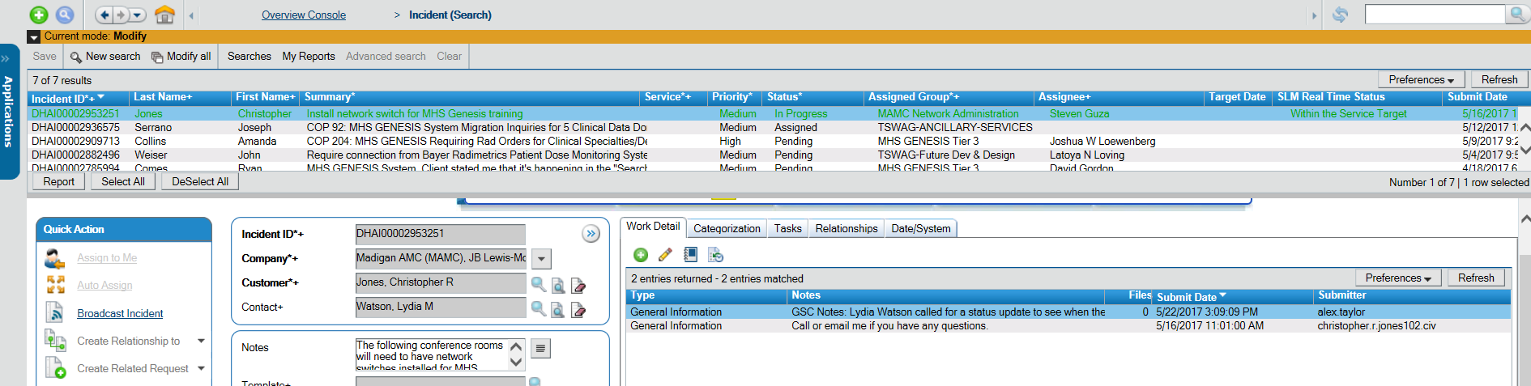
Searching for an Incident (4 of 4)
If there is more than one incident matching your search criteria, the results will appear at the top of the screen. Scroll through the results to see all related incidents.
Note: The red and green designations of these incidents are not relevant to MHS GENESIS incident management
Notes:
If there is more than one incident matching your search criteria, the results will appear at the top of the screen. Scroll through the results to see all related incidents.

Slide 10
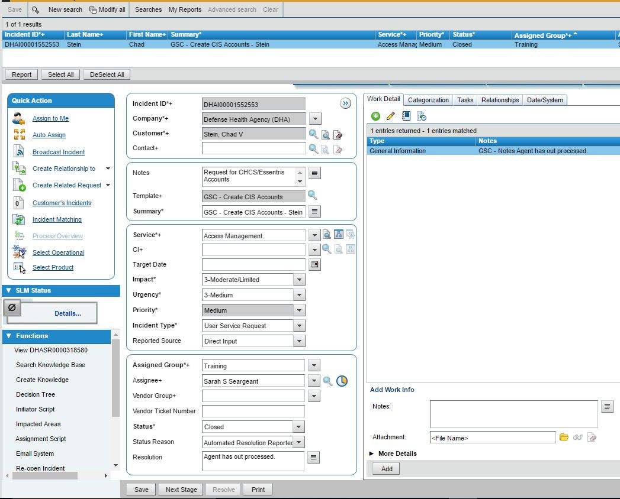
Incident Information
On the right, the Work Detail tab will display the Work Info Notes. This is the history of the incident.
Assigned Group is the team currently working the incident
Assignee is the person on that team to whom the incident is assigned. Clicking the search icon will give you the contact info of the assignee
The Notes field contains the request made
See next slide for Status explanations

Slide 11
Interpreting Incident Status
Assigned: This is the initial default status when an incident is assigned to a team. If there is no Assignee listed, the incident has not yet been reviewed
In-Progress: The team/Assignee is actively working resolution
Pending: The Assignee is awaiting more information. Status Reasons:
Client Action Required: More information is needed from the submitter. Check the Work Information Notes to see what is needed.
Support Contact Hold: The incident is pending reassignment to the OCHIO
Monitoring Incident: Generic hold status. Likely the Assignee is gathering data to support the request
Others: Infrequently used. Review the WINs or contact the assignee for more info.
Resolved: When an incident is being closed, it first goes into a Resolved status. It remains in this status for 5 days, during which the incident can be reopened by contacting the Assignee or someone on the Assigned Group team. Contact your Site Integrator if assistance is needed.
Closed: Final status to indicate the team/Assignee believes the issue was resolved. Once an incident is Closed, it cannot be reopened and a new ticket must be submitted.

Slide 12
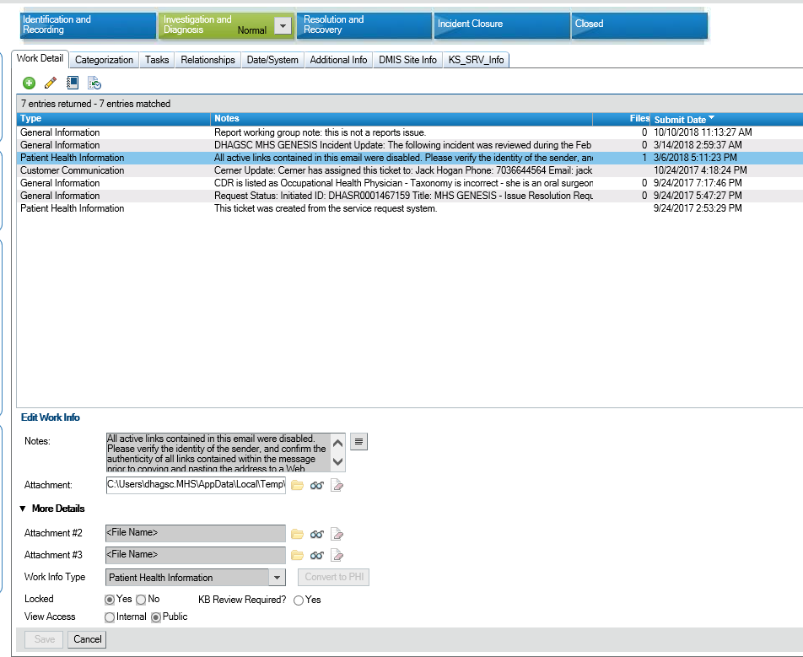
Viewing Attachments
1
If a WIN has an attachment, you’ll see a number next to the note
To open the attachment, double click on the WIN and click the “view attachment” icon
2

Slide 13
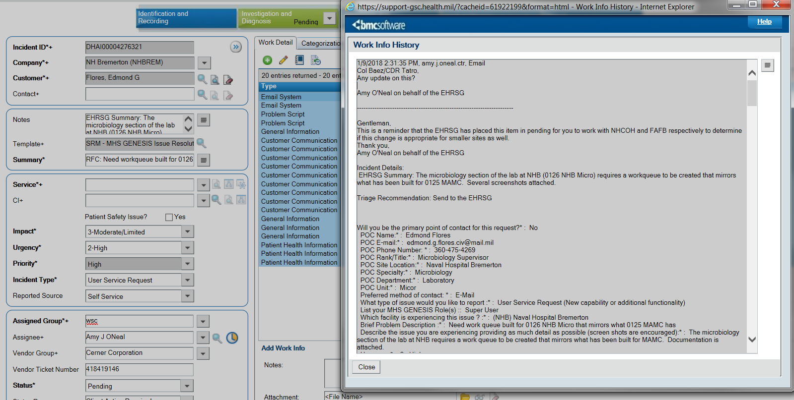
Viewing WINs
To view all WINs at once (to read the history of the incident), click the “History” button at the top of the WIN field

Slide 14
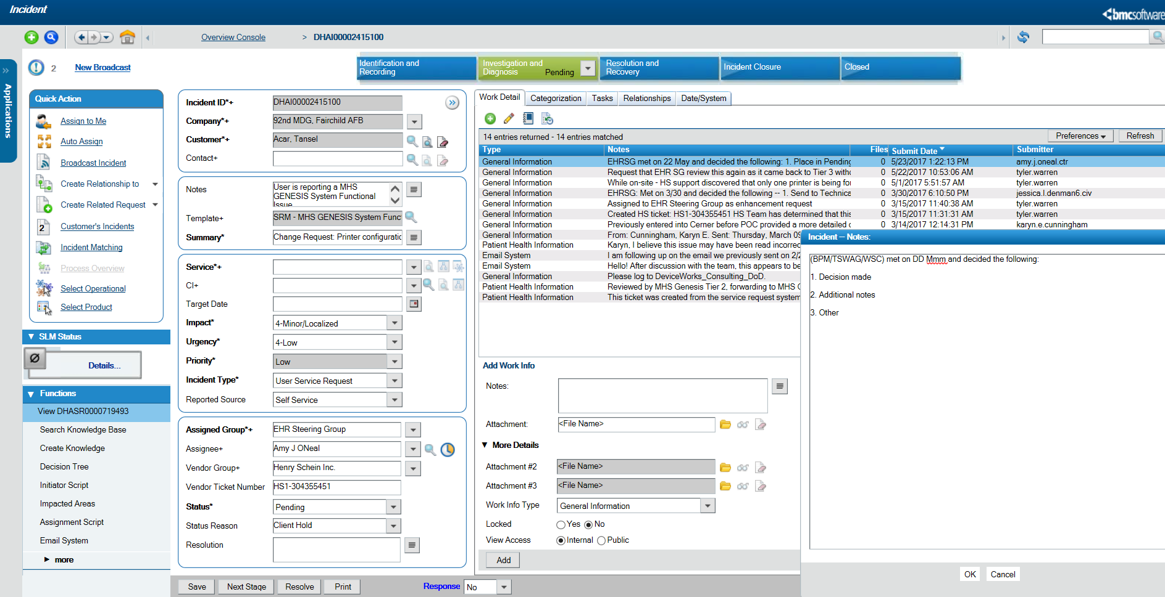
Adding Work Information Notes (WINs)
Open the incident and click “Add Work Information Note”
Expand the field
2b. Click the file folder to add attachments
Add WINs (See next slide for format)
Expand field by clicking arrow next to “More Details”
Unlock WIN
Click “Add”
1
2
3
4
2b
5
6
Notes:
Open the incident and click “Add Work Information Note”
Expand the field
2b. Click the file folder to add attachments
Add WINs (See next slide for format)
Expand field by clicking arrow next to “More Details”
Lock WIN
Click “Add”

Slide 15
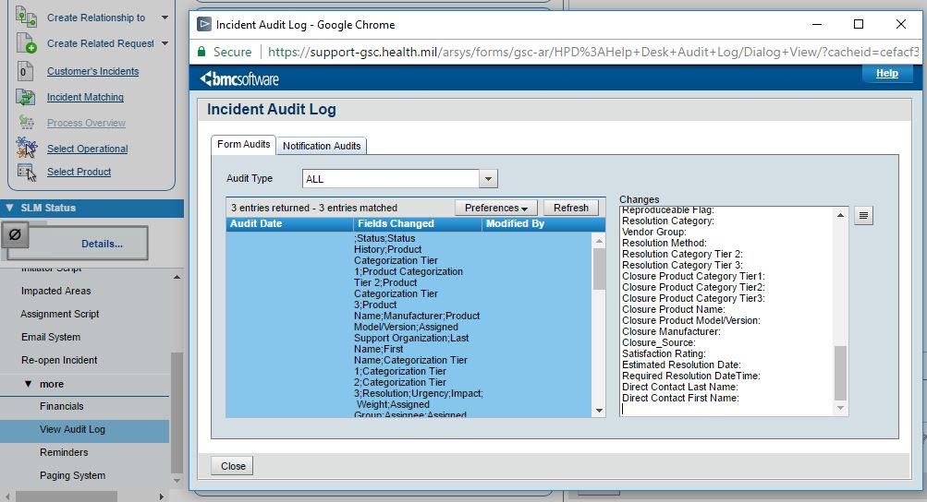
Viewing the Audit Log
From the Incident, you can also check the Incident Audit Log to find a history of changes that have been made to the Incident.
To open the Audit Log, click Functions > More > View Audit Log.
Click Form Audits tab.
The Fields Changed column displays fields that have been changed.
The Modified By column displays the Submitter ID of the individual that modified the fields.
Changes column displays the changes made to the fields.
The Notification Audits tab displays any notification emails sent by Remedy to Assigned Groups or the Customer.

Slide 16
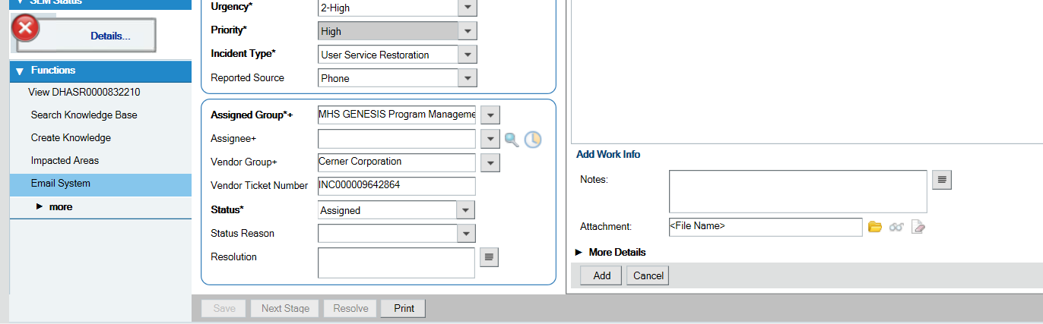
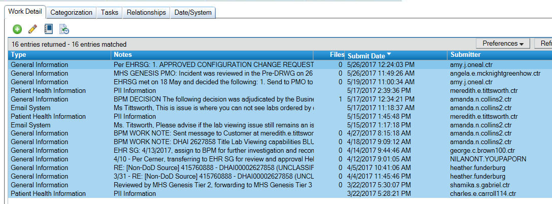
Printing an Incident (1 of 2)
Open the incident and click “Print” at the bottom of the screen. Save this file as the Incident ID#
Highlight all WINs
Click “Report”. Save this file as (Incident ID – WINs)
1
3
2
Notes:
Open the incident and click “Print” at the bottom of the screen. Save this file as the Incident ID#
Highlight all WINs
Click “Report”. Save this file as (Incident ID – WINs)

Slide 17
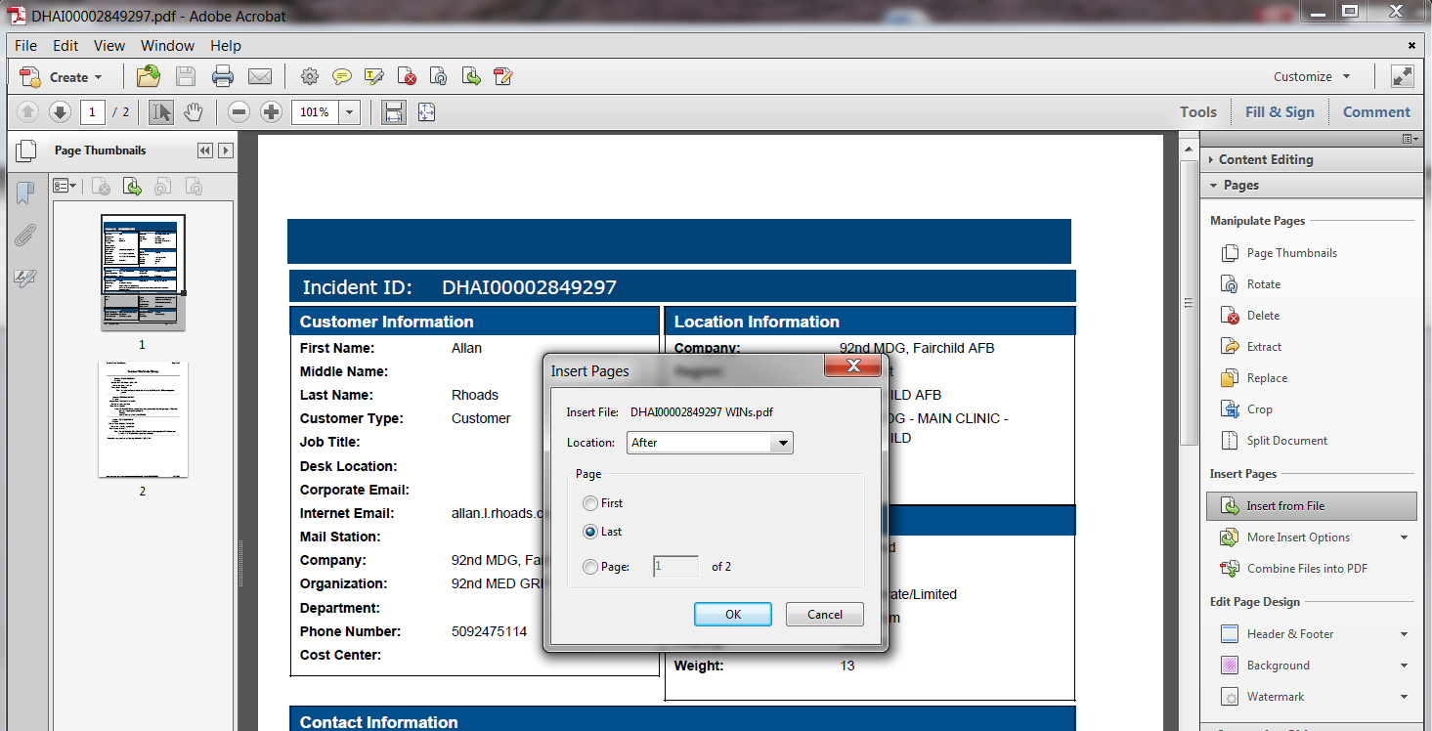
Printing an Incident (2 of 2)
4
In the Incident ID pdf, click “Tools”
Under “Insert Pages”, click “Insert from file”
Choose the Incident ID – WINs file
Ensure “Location” says “After”
Click “Last”
Click “OK”
The WINs will now be at the end of the Incident ID pdf. Save the document and close.
6
7
5
8
9
Notes:
4. In the Incident ID pdf, click “Tools”
5. Under “Insert Pages”, click “Insert from file”
6. Choose the Incident ID – WINs file
7. Ensure “Location” says “After”
8. Click “Last”
9. Click “OK”
The WINs will now be at the end of the Incident ID pdf. Save the document and close.

Slide 18

Questions
Send follow up e-mails to DHMSM Deployment at
dha.ncr.deployment.mbx.dhmsm-deployment@mail.mil

